Slide 1


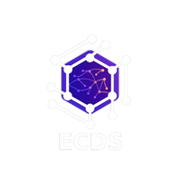


ECDS
SmartMed AI
Team name: BACK PROPAGANDA

Slide 2
ECDS
“TEAM MEMBERS”
Deepak Raj S
Divya Dharshan D
Giridharan
Akshayaa Elangovan

Slide 3
ECDS
PROBLEM STATEMENT:
Traditional hospital information systems rely on static FAQ bots that fail to resolve complex, multi-fact queries, such as linking doctor availability with specific insurance coverage. This leads to overwhelmed front-desk staff, outdated information on public platforms, and significant friction for patients attempting to navigate hospital services. There is a critical need for an intelligent, context-aware agent that can reason across multiple data domains in real-time while maintaining an automated, up-to-date knowledge base.

Slide 4

ECDS
Proposed Solution:
Reasoning-Based Intelligence(Contextual RAG): Uses Retrieval-Augmented Generation to answer multi-part questions
Multi-Domain Reasoning Capable of processing simultaneous constraints in a single response, such as linking a doctor's specific availability with an insurer's coverage rules.
Knowledge Graph Architecture employing a structured data design to map relationships between hospital departments, doctor specialties, and insurance partners.
Automated Refresh Detecting stale data and triggers webhooks to pull live updates from the hospital's management system
Identifies complex or private queries (like billing) that a bot shouldn't handle and collects patient details and creates a callback request ticket for the relevant department

Slide 5
Proactive Journey Management:Guides the patient from initial search through appointment booking instead of just answering questions.Automated WhatsApp Prep-Kits:Instantly sends parking details and fasting instructions to the patient’s phone after booking.Zero-Friction UI:Replaces the confusing blank chat interface with proactive action buttons that guide patients on what to do next
ECDS
INNOVATION USP
The Innovation (Our Technical Edge)Graph-RAG Architecture:
Maps relational data (Doctor → Parking → Preparation) instead of searching flat, disconnected FAQs.
Localized NLP Engine:
Processes fuzzy inputs and typos instantly without the high cost and latency of constant LLM API calls.
Self-Healing Data Sync:
Simulated webhooks continuously verify data integrity so information never becomes outdated.
Proactive Journey Management:
Guides the patient from initial search through appointment booking instead of just answering questions.
Automated WhatsApp Prep-Kits:
Instantly sends parking details and fasting instructions to the patient’s phone after booking.
Zero-Friction UI:
Replaces the confusing blank chat interface with proactive action buttons that guide patients on what to do next.

Slide 6
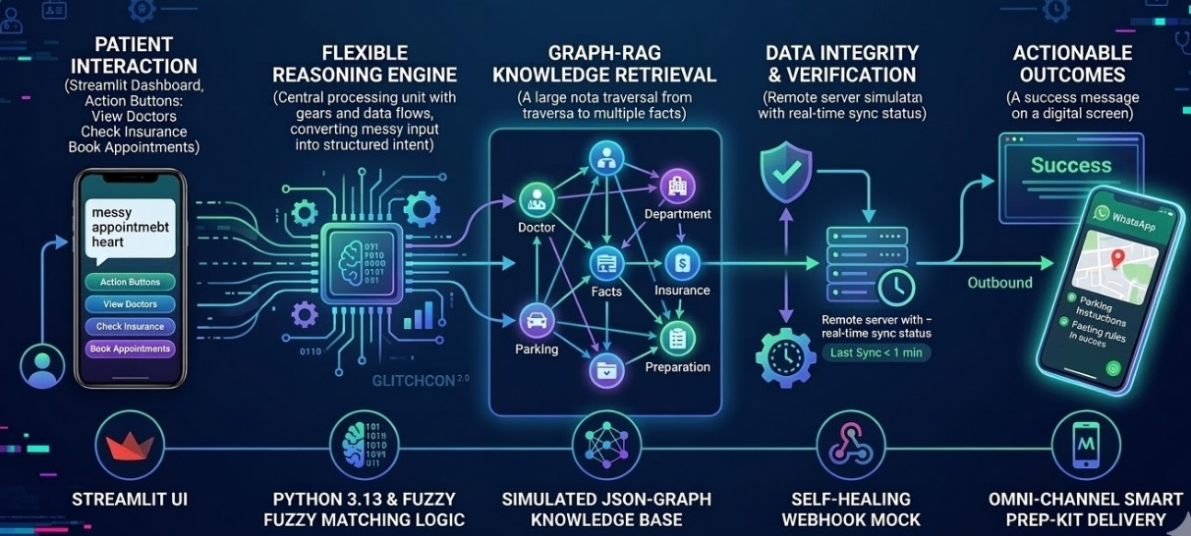
ECDS
WORKFLOW DIAGRAM WITH TECH STACK:

Slide 7
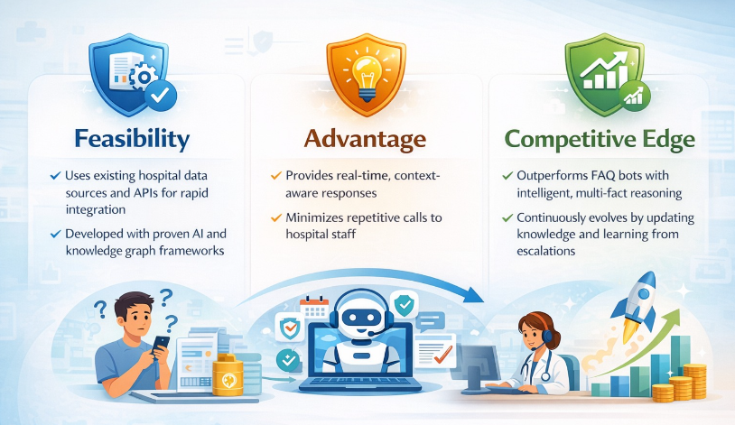
ECDS
FEASABILITY:
Robust Architecture: Combines RAG for conversational flexibility and Knowledge Graphs for multi-fact reasoning—ensuring high accuracy.
API-First Design: Operates as a middleware layer; integrates with existing HMS via webhooks without replacing legacy systems.
Safety-First Logic: Employs Human-in-the-Loop design; automatically routes private or medical queries to staff to mitigate clinical liability.
Scalable Framework: Modular structure supports rapid expansion across new departments, channels (voice/chat), and data sources.

Slide 8
ECDS
NOVELTY
Graph-Based Reasoning: Moves beyond keyword matching to multi-hop logic, linking doctors, procedures, and insurance in a single response.
Active Learning Loop: Automatically logs "unanswered queries" to build a Knowledge Gap Map, ensuring the system learns and improves weekly.
Proactive Engagement: Shifts from passive to proactive by auto-sending personalized checklists (fasting, docs, parking) before appointments.
Clinical Integrity: Implements a Hybrid Concierge Model—AI handles info retrieval, while all sensitive billing/medical queries are routed to humans to eliminate hallucinations.

